Slide 1
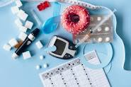
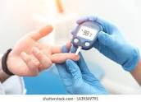

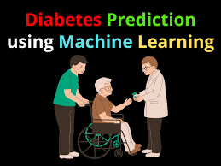
DIABETES PROJECT

Slide 2
INTRODUCTION:
The goal of this project is to develop a machine learning model that can predict the likelihood of a patient being readmitted to the hospital within 30 days of discharge. This is a real-world problem that can have significant impacts on patient outcomes and healthcare costs. The dataset provided for this project contains information on more than 100,000 patient hospitalizations

Slide 3
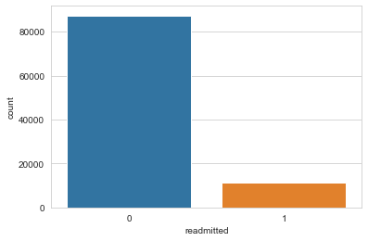
Insight from above graph: Our target variable is imbalance. Number of readmitted patient are quite less as compared to Not readmitted

Slide 4
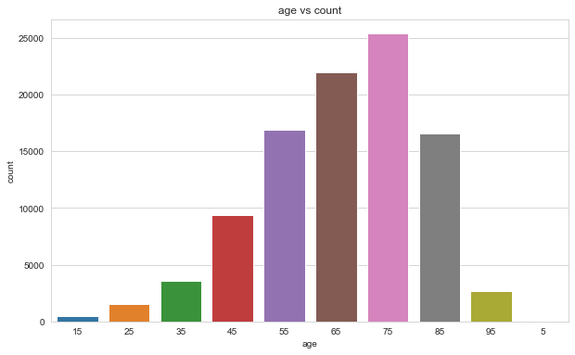
Insight from above graph : people with age group 75 have maximum count

Slide 5

Insight from above graph: race Caucasian is the highest followed by AfricanAmerican

Slide 6
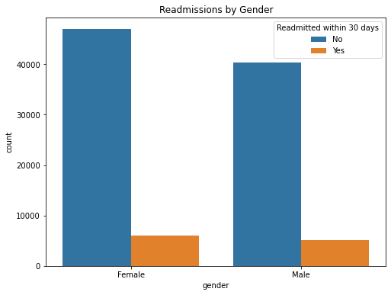
Insight from above graph: from the above graph we can say that the readmission rate of female is more as compared to male

Slide 7
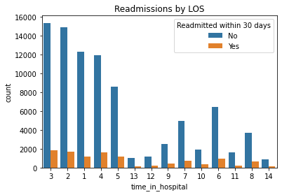
Insight from above graph: Mostly patient between 2 to 4 days are admitted frequently

Slide 8
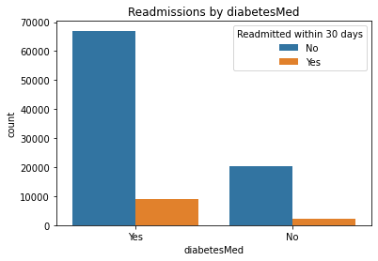
Insight from above graphs: Patients provided with diabetes medication are readmitted often

Slide 9
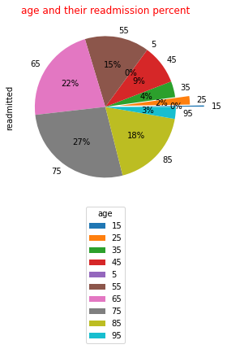
Insight from above graph: From age feature we can see that majority of patients have higher age(ie 85,75,65,55) , age can be one of the factors for early readmission

Slide 10
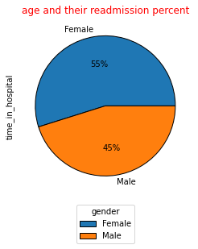
Insight from above graph: Female have spend more time in hospital

Slide 11
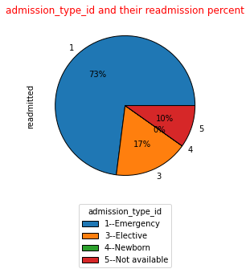
Insight from above graph: Admission_type_id 1(i.e Emergency) have a large readmission rate followed by admission_type_id 3(i.e elective)

Slide 12
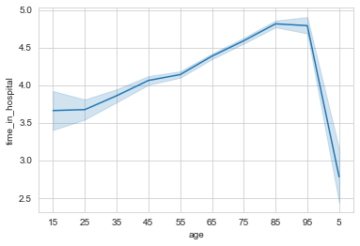
Insight from above graph: The age group between 85 to 95 have spend maximum time in hospital

Slide 13
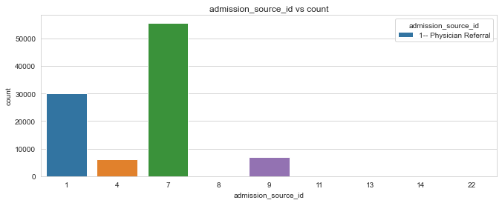
Insight from above graph: admission_source_id 7 (ie emergency room) is the highest

Slide 14
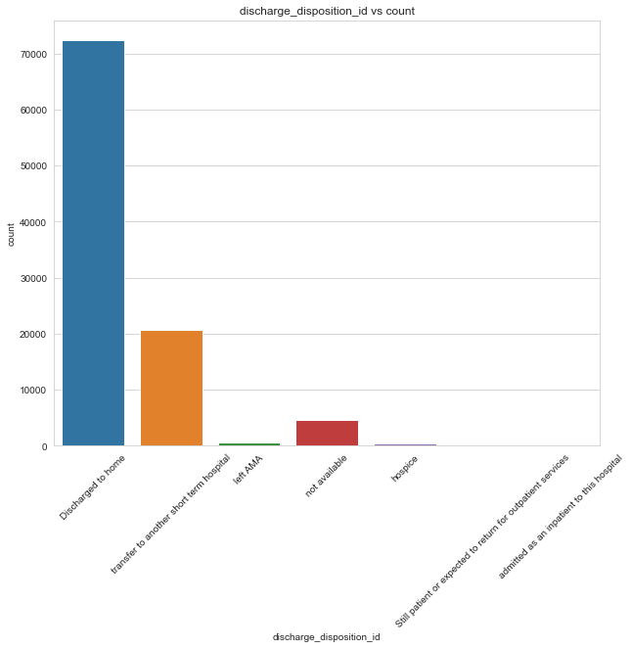
Insight from above graph: Discharge id 1 ie dischage to home is the highest in our data followed by id 2 ie transfer to another short term hospital

Slide 15
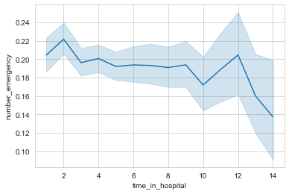
Insight from above graph: as the time in hospital increased the number of emergency decreased (13-14 there is a huge drop in number of emergency)

Slide 16
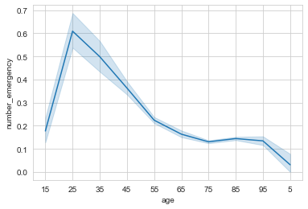
Insight from above graph:maximum number of emergecy were at the age of 25

Slide 17
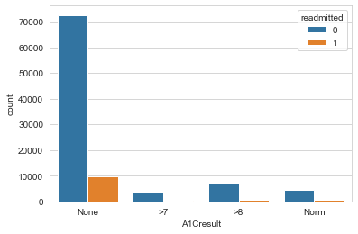
Insight from above graph: Patient who doen't take a1ctest is readmitted often

Slide 18
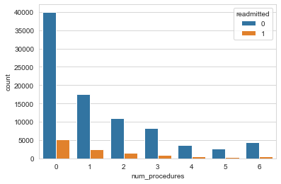
Insight from above graph:less the number of prcedures more the count of readmission

Slide 19
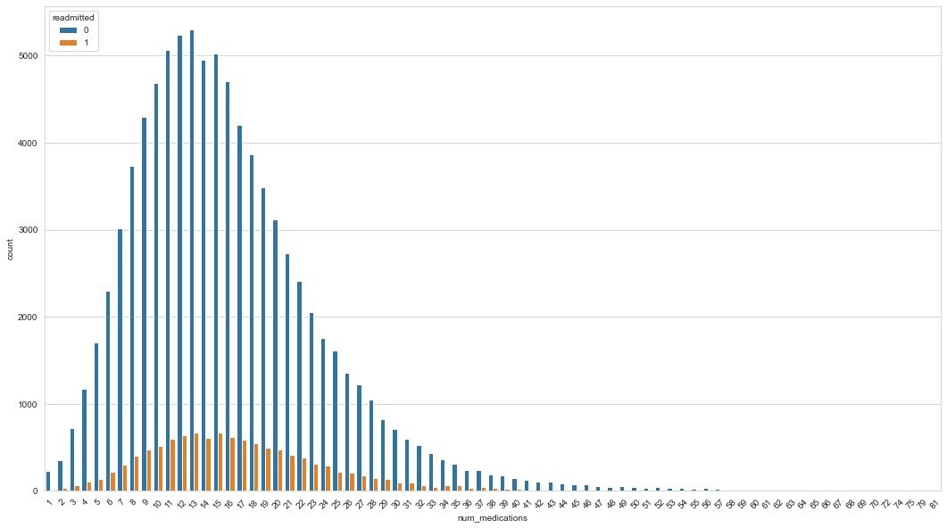
Insight from above graph:as we can see number of medications between 9 to 20 have high chance of readmission

Slide 20
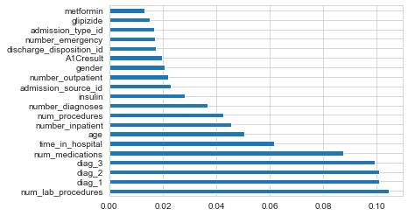

Slide 21
Conclusion
Six major features are found to have high impact on diabetes patient readmission: number of lab procedures,diag1,diag2,diag3, number of medications, time spent in hospital
The logistic regression classifier modeling achieves 0.69 accuracy and can be considered as the best for our dataset
To correctly predict the readmission , hospitals should carefully examine the clinical data of patients and pay special attention to the above major features.
Some other features might be worth collecting, for example,family history.
This analytic method can be applied to different diseases other than diabetes.
In conclusion, ML could help healthcare providers to identify those patients who are prone to short-term readmission and might reduce the probability of readmission within 30 days by altering the risk factors.

